Slide 1
LTAR– Current and Future
Sally Schneider
Deputy Administrator
Natural Resources & Sustainable Agricultural Systems
USDA ARS, Office of National Programs

Slide 2
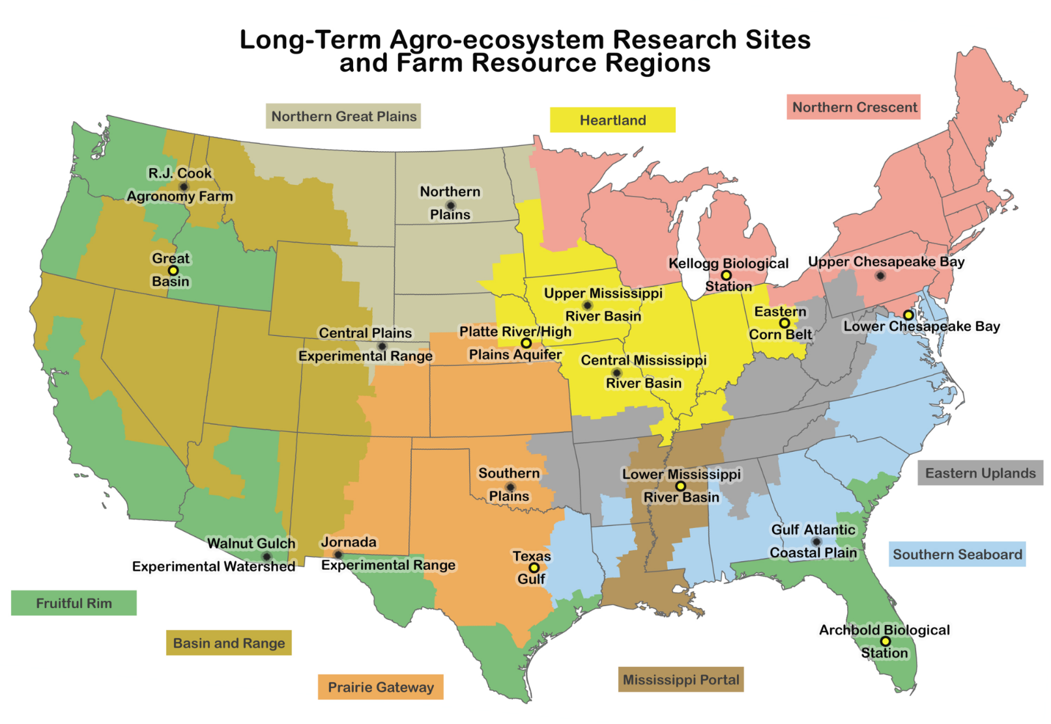
2014 Workshop – Nunn, CO
First Workshop of 18 Site Network

Slide 3
2015 Workshop – Beltsville, MD

Slide 4
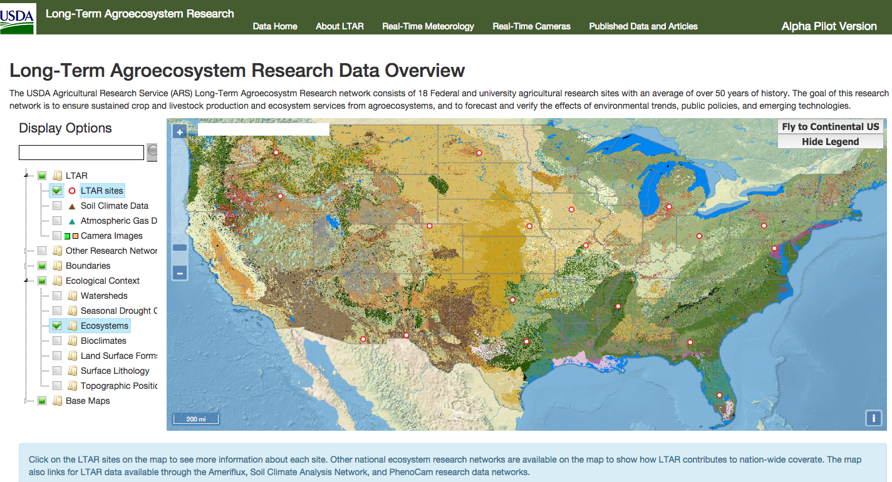
https://ltar.nal.usda.gov/
Notes:
Scheduled harvesting from external repositories (including geospatial ISO metadata)

Slide 5

2016
LTAR is growing and maturing
You can be proud

Slide 6
Accomplishments
Short, medium, and long-term
$30+ million invested so far

Slide 7
Low Performers?

Slide 8
Exciting Times
Grand Challenge
GxExM
LTAR
Big Data
Climate Hubs

Slide 9
Similarities?
“Each LTAR site will provide data and test the broad hypothesis that net primary productivity and yield, food safety and quality, and use efficiency of agricultural inputs can be increased while maintaining or improving delivery of ecosystem services.”
LTAR Shared Research Strategy
Transform Agriculture to Deliver a 20% Increase in Quality Production at 20% Lower Environmental Impact by 2025
- Grand Challenge

Slide 10
YRL Grand Challenge Summit April 2016

Slide 11
Funding
Leadership

Slide 12
Funding Vision
Fully fund all LTAR sites
HQ funds for one time needs, etc

Slide 13
Budget Calendar 18 Months – April-October
Executive Process
Spring Planning for Budget
Assimilate Prior Input
Agency Estimates
Administrator’s Request to the Secretary
Department Estimates
Secretary’s Allowance to Agency and Request to the President
Budget Estimates
OMB’s Allowances to Department and President’s Request to Congress
President’s Budget Submission to Congress
April-May
June-July
August-September
October-January
February

Slide 14
Budget Calendar (cont.)
Legislative Process
House and Senate Hearings
House and Senate Mark-up Bills
Conference and Final Bills*
Presidential Enactment of Bill*
February-April
May-August
September*
October*
*These actions often are delayed, resulting in a Continuing Resolution in the new fiscal year at the prior year spending level until Congress passes and the President signs the new appropriations law.

Slide 15
FY14 Budget
Very Unusual
Funded original 10 LTAR sites

Slide 16
Class of 2014 LTAR Sites
Included in FY16 President’s Budget
Not funded by Congress
Why not in FY17 President’s Budget?
Is that it for FY17?

Slide 17
What Happens Next?
Continue to seek permanent funding
Interim Strategies
ARS projects
Grant funding? AFRI? FFAR?
Traditional and Non-traditional partners?
Other funding sources?
Marketing strategies?
Your ideas?

Slide 18
Leadership
LTAR began as one NPL leading a group of Experimental Watersheds and Experimental Ranges
Growth in size and diversity calls for consideration of other approaches

Slide 19
Leadership
ONP Leadership
Team of 4 National Program Leaders
Systems/Sustainability, Animals, Crops, Quality/Nutrition/Food Safety
Team Leader – Charlie Walthall
NPL for Systems/Sustainability

Slide 20
Leadership
Field Leadership
Structure – TBD
GRACEnet model?
Team? What size?
Revolving? Dedicated?
Admin Support?

Slide 21
Discussion – ½ of Remaining Time for Each
Funding
Ideas for interim solutions
Leadership
Ideas for Field Leadership

Slide 22
Funding
Seek permanent funding for the dream
Interim Strategies
ARS projects
Grant funding? AFRI? FFAR?
Traditional and Non-traditional partners?
Other funding sources?
Your ideas?

Slide 23
Leadership
Field Leadership
Structure – TBD
GRACEnet model?
Team? What size?
Revolving? Dedicated?
Admin Support?

Slide 24
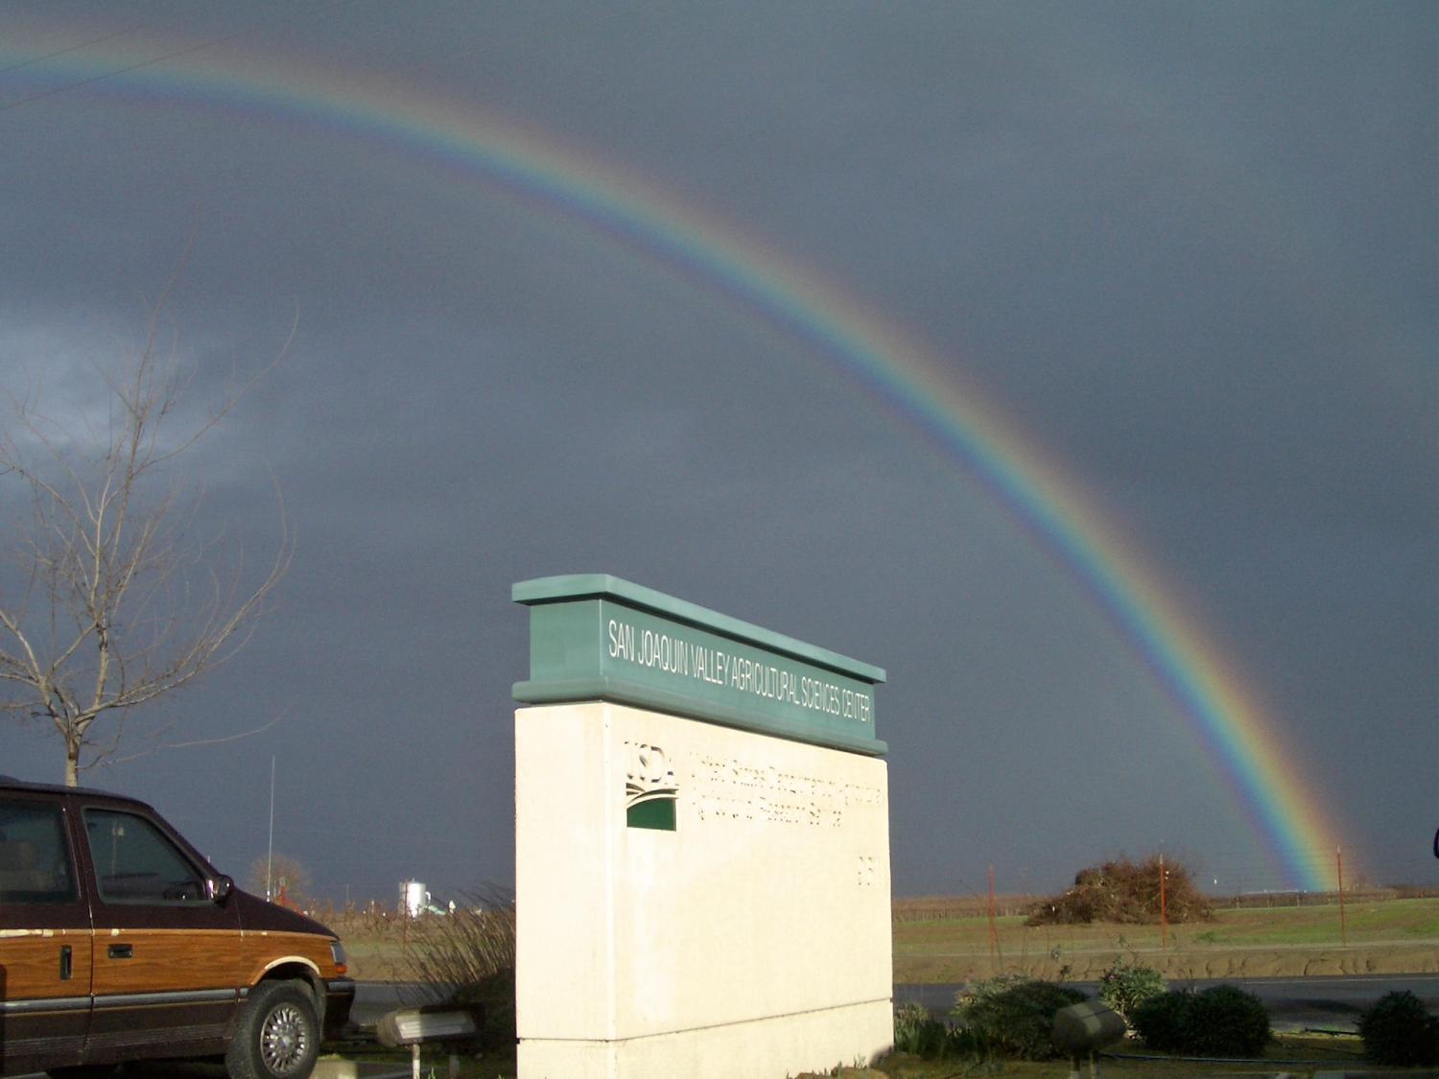
Thank You!

